Slide 1
Planning and Scheduling

Slide 2
Role of the Project Manager
Project management – organizing and directing people to achieve a planned result within budget and on schedule
Success or failure of project depends on skills of the project manager
  Beginning of project – plan and organize (Baseline plan)
  During project – monitor and control (observe departures from our schedule and budget and we intervene to return ideally, to the baseline plan)
Responsibilities are both internal and external

Slide 3
Internal Responsibilities
Identify project tasks and build a work breakdown structure
Develop the project schedule
Recruit and train team members
Assign team members to tasks
Coordinate activities of team members and subteams
Assess project risks
Monitor and control project deliverables and milestones
Verify the quality of project deliverables

Slide 4
External Responsibilities
Report the project’s status and progress
Establish good working relationships with those who identify the needed system requirements
  The people who will use the system
Work directly with the client (the project’s sponsor) and other stakeholders
Identify resource needs and obtain resources

Slide 5
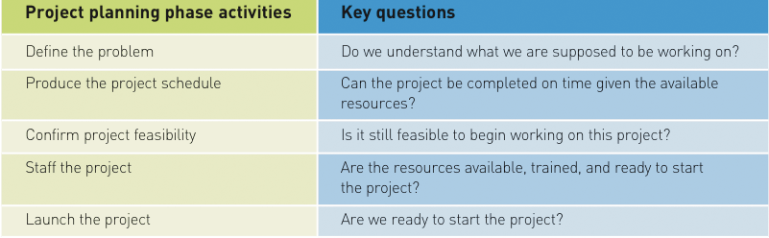
Activities of the Project Planning Phase

Slide 6
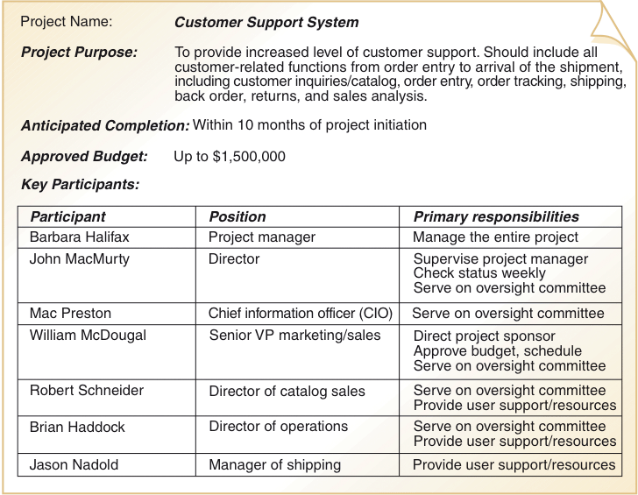
Project Charter
(Software Artifact)

Slide 7
Work Breakdown Structure
Producing the Project Schedule
  Develop work breakdown structure (WBS)
    List of tasks and their durations required for project
    Similar to outline for research paper
    WBS is foundation for project schedule
  Build a PERT/CPM chart
    Assists in assigning tasks
    Critical path method
    Gantt chart and tracking GANTT chart

Slide 8
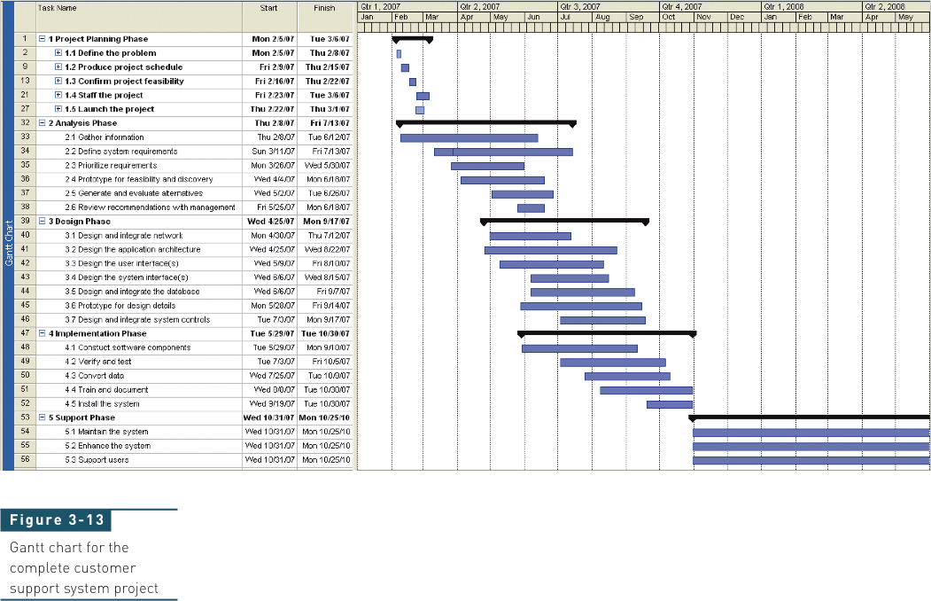
Gantt Chart

Slide 9
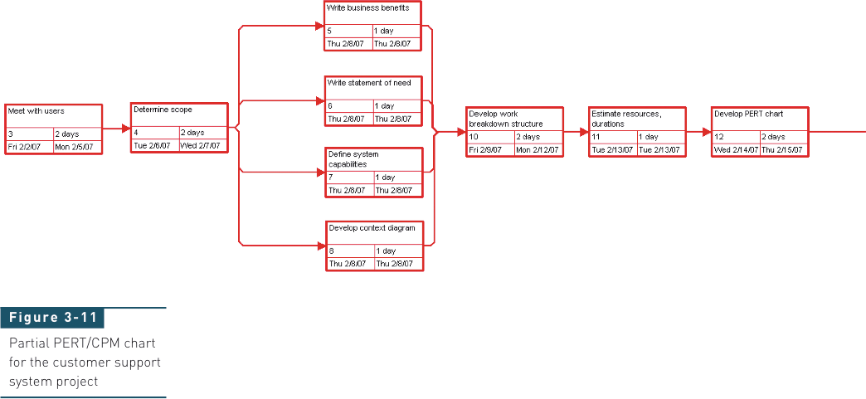
Partial PERT Chart

Slide 10
Critical Path Analysis
Originally known as Project (or Program) Evaluation and Review Technique (PERT)¹, it is also called Network Analysis.
A project is viewed as a set of activities or tasks, each of which has an expected duration.
Completion of an activity corresponds to a milestone or event for the project.
Each milestone also represents the start of activities that are directly dependent on the completion of the predecessor or predecessors.
CPA is based on an analysis of sequential dependencies among the activities, and uses the expected duration for each task to derive an estimate of the overall duration of the project.
In particular, it identifies any inter-task dependencies that are critical to the project duration—collectively these are known as the critical path.

Slide 11
The preparation of a CPA chart involves the following steps.
List all project activities and milestones
Determine the dependencies among the activities
Estimate the duration of each activity
Draw the CPA chart
Identify critical path

Slide 12
Activity | Description | Milestone | Preceding activities | Expected duration (days) | Staffing
A | Interview users | 2 | - | 5 | 2
B | Prepare use cases | 3 | - | 2 | See A
C | Review use cases | 4 | A,B | 2 | 3
D | Draft screen layouts | 5 | C | 2 | 2
E | Review screens | 6 | D | 2 | 2
F | Identify classes | 7 | C | 2 | 3
G | CRC analysis | 8 | F | 4 | 3
H | Prepare draft class diagram | 9 | F | 5 | 3
I | Review class diagram | 10 | G, H | 4 | 4

Slide 13



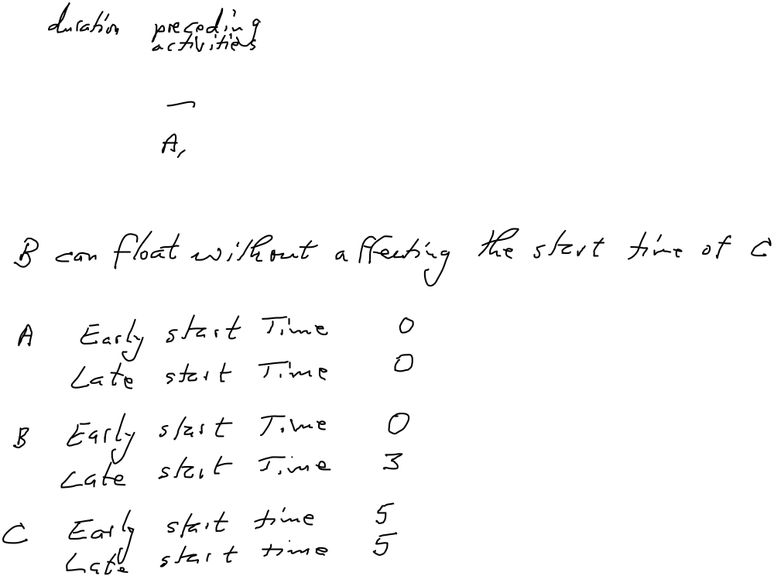


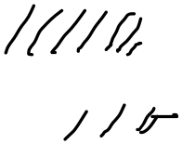

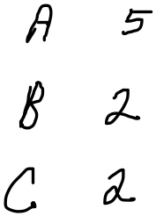












Slide 14
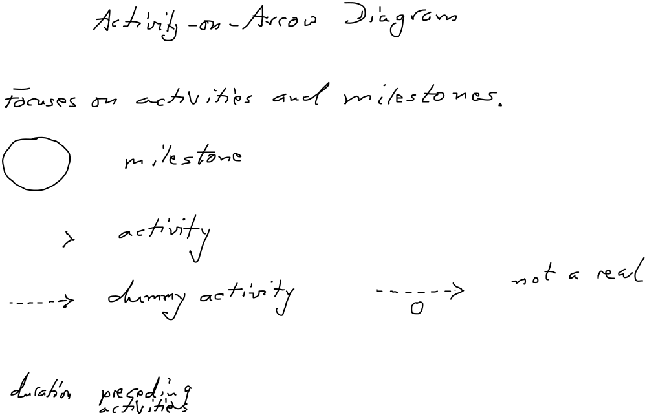
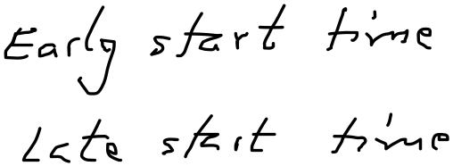






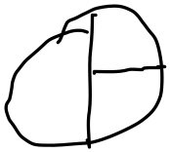










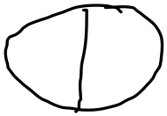



Network Diagrams

Slide 15
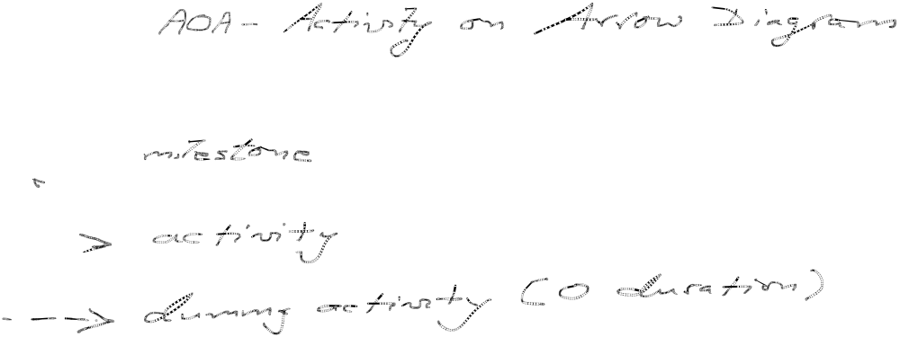
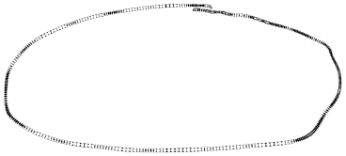
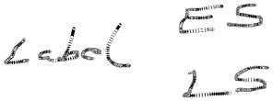
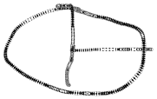
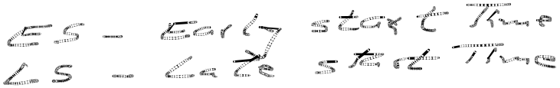


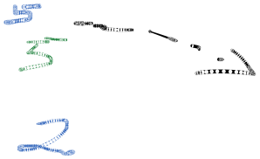


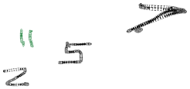








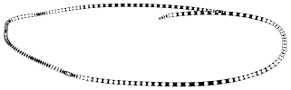


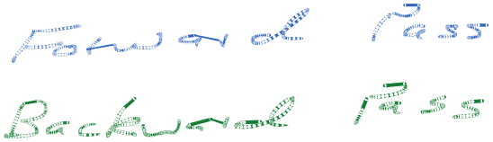

Slide 16
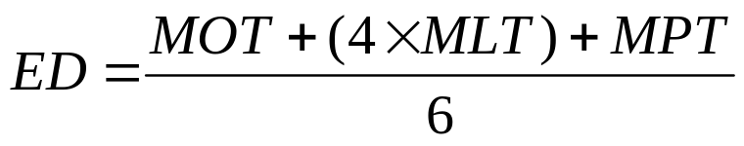
Estimate the duration of each activity
Several different approaches to this. One is the following:
  Where ED is the Expected Duration of a task
  MOT is the most optimistic time
  MLT is the most likely time
  MPT is the most pessimistic time for its completion
  Thus ED is a weighted average of the three estimates.

Slide 17
Each MOT assumes that a task will not be delayed, even by likely events such as employee absence.
The MPT assumes that most things that can go wrong will go wrong, and that completion of the activity will be delayed to the maximum plausible extent. Equipment will arrive late, technical problems will occur and some staff will be ill.

Slide 18
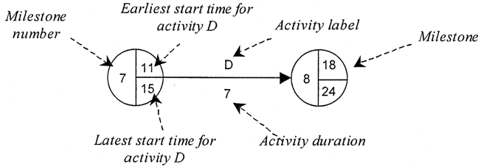
Draw the CPA chart
Two main styles of notation are used for CPA charts, known respectively as ‘activity on the node’ and ‘activity on the arrow’ diagrams. We will use ‘activity on the arrow’.
Notation:

Slide 19

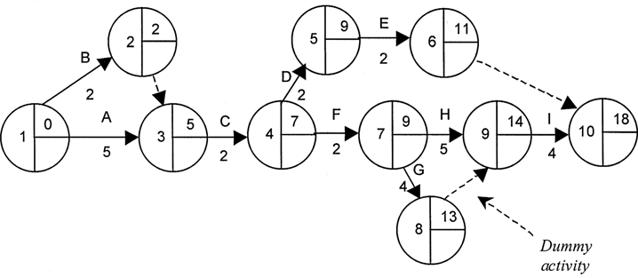
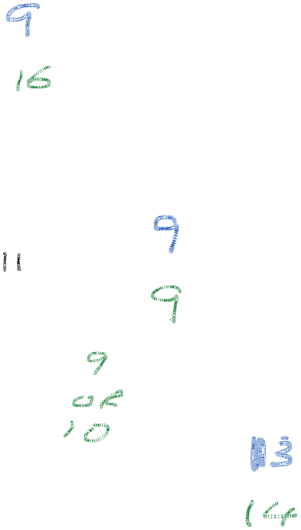

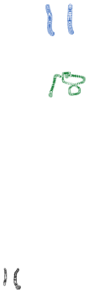


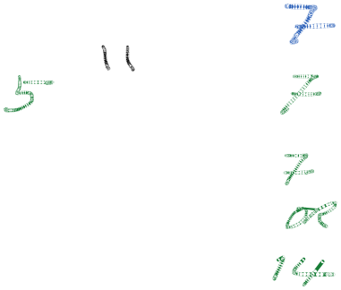


Example network

Slide 20
Earliest Start Time
The next step is to enter an earliest start time for each milestone. This is done by working through the diagram from the very first milestone to the very last (sometimes called a forward pass).
  It is a convention that the EST for the first milestone is set to 0 (elapsed time is usually measured in days, but any other unit of time can be used equally well).

Slide 21
Latest Start Time
The next step requires completing the latest start time for each milestone. The latest start time is entered by working back from the last milestone (sometimes this is called a backward pass). The LST for the last milestone is set equal to its EST. Each preceding LST is then calculated as follows. The LST for most milestones equals the LST for its successor minus the ED of the intervening activity.

Slide 22
Identify the Critical Path
Once all LSTs have been entered onto the diagram, the slack time (or float) for each activity can be calculated.
This is the difference between an activity’s EST and its LST, and it represents the time by which that particular activity can be delayed without affecting the overall duration of the project.
The path through all milestones that have a slack time of 0 is called the critical path. This is indicated by a double bar across activity arrows that connect the milestones. These milestones, and their intervening activities, are critical to the completion of the project on time.
Milestones that have an EST that is different from their LST are not critical, in the sense that they have some scheduling flexibility.

Slide 23
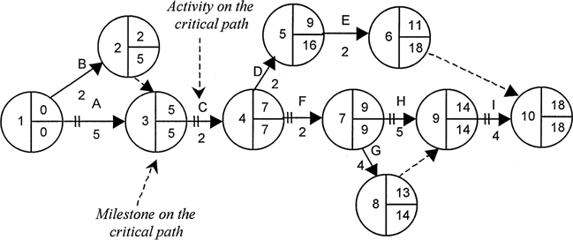
Final Network Diagram

Slide 24
Algorithm!
Event Numbering Algorithm
  Step 1: Give the starting event number 0.
  Step 2: Give the next number to any unnumbered event whose predecessor events
  are each already numbered.
  Repeat Step 2 until all events are numbered.
Earliest Event Time Algorithm
  Step 1: Let E(0) = 0.
  Step 2: For j = 1,2,3,...,n (where n is the last event),
  let E(j) = maximum {E(i) + D_{ij}}
  where the maximum is computed over all activities (i,j) that have j as the ending event.
Latest Event Time Algorithm
  Step 1: Let L(n) equal the required completion time of the project.
  Note: L(n) must equal or exceed E(n).
  Step 2: For i = n-1, n-2, ..., 0, let
  L(i) = minimum {L(j) - D_{ij}}
  where the minimum is computed over all activities (i,j) that have i as the starting event.

Slide 25
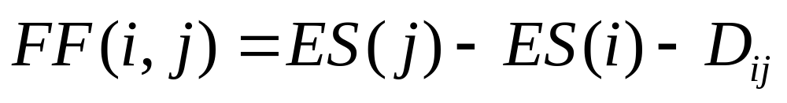
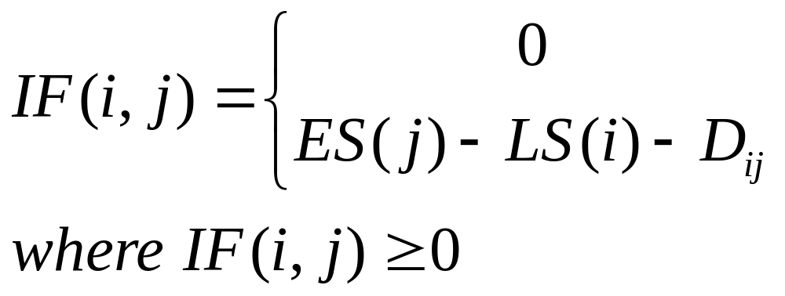
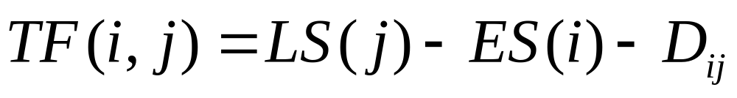
Additional Calculations
Free Float
Independent Float
Total Float

Slide 26
Additional
Free Float
  The amount of delay which can be assigned to any one activity without delaying subsequent activities (those that come afterwards).
  takes into consideration the effect on subsequent activities of a delay
Independent Float
  The amount of delay which can be assigned to any one activity without delaying subsequent activities or restricting the schedule of preceding events.
  The independent float of an activity is calculated assuming the worst circumstances, i.e. the activity's predecessors finish at their latest times and we want subsequent activities to begin at their earliest times. If this is possible, and there is still time to spare, then this is called independent float.
Total Float
  The maximum amount of delay which can be assigned to any activity without delaying the entire project assuming no extension or delay in any other activity. A critical activity can be defined as one which has a total float of zero.

Slide 27
Figures from Java program
E L
0.0 0.0
2.0 5.0
5.0 5.0
7.0 7.0
9.0 16.0
11.0 18.0
9.0 9.0
13.0 14.0
14.0 14.0
18.0 18.0

Slide 28
Figures from Java program
i j FF IF TF
1, 2 0.0 0.0 3.0
1, 3 0.0 0.0 0.0
2, 3 3.0 0.0 3.0
3, 4 0.0 0.0 0.0
4, 5 0.0 0.0 7.0
4, 7 0.0 0.0 0.0
5, 6 0.0 0.0 7.0
6, 10 7.0 0.0 7.0
7, 8 0.0 0.0 1.0
7, 9 0.0 0.0 0.0
8, 9 1.0 0.0 1.0
9, 10 0.0 0.0 0.0

Slide 29
Activity | Description | Predecessors | Duration
A | Preliminary Design | -- | 6
B | Evaluation of Design | A | 1
C | Contract Negotiation | -- | 8
D | Preparation of Fabrication Plant | C | 5
E | Final Design | B, C | 9
F | Fabrication of Product | D, E | 12
G | Shipment of Product to Owner | F | 3

Slide 30
Exercise (Must Succeed)
Create an “activity on arrow” network for the predecessor table given on the previous slide
Perform all calculations.

Slide 31
Common CPM Errors
Estimated activity durations may be wrong
Predecessor relationships may contain cycles
List of prerequisites contains more than the immediate predecessors
Some predecessor relationships may be overlooked
Some listed predecessor relationships may be spurious
Some tasks may be missing

Slide 32
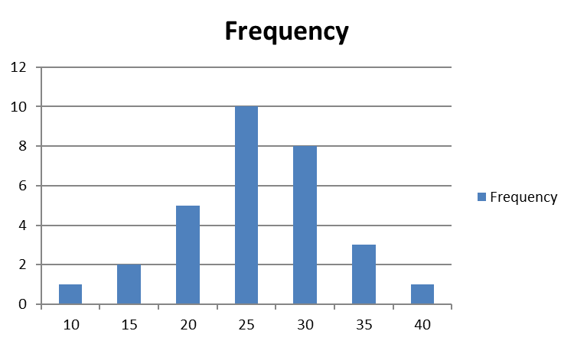
PERT (Program Evaluation and Review Techniques)
Activity durations are stochastic in reality
The actual durations are affected by:
  Individual skills
  Learning curves, etc

Slide 33
CPM vs PERT
Difference is in how activity duration is treated
CPM – assumes time estimates are deterministic
  Obtain activity durations from previous projects
  Suitable for “construction” type projects
PERT – treats durations as probabilistic
  PERT = CPM + probabilistic task times
  Better suited to Research and Development projects
  Limited previous data to estimate time durations
  Captures schedule (and implicitly some cost) risk

Slide 34
PERT
Program Evaluation and Review Technique
Task time durations are treated as uncertain
  A : optimistic time estimate
    Minimum time in which the task could be completed
    Assuming everything goes right
  M : most likely time estimate
    The task duration under “normal” working conditions
    The most frequent task duration based on past experience
  B : pessimistic time estimate
    The Time required under particularly “bad” circumstances
    Most difficult to estimate, includes unexpected delays
    Should be exceeded no more than 1% of the time

Slide 35
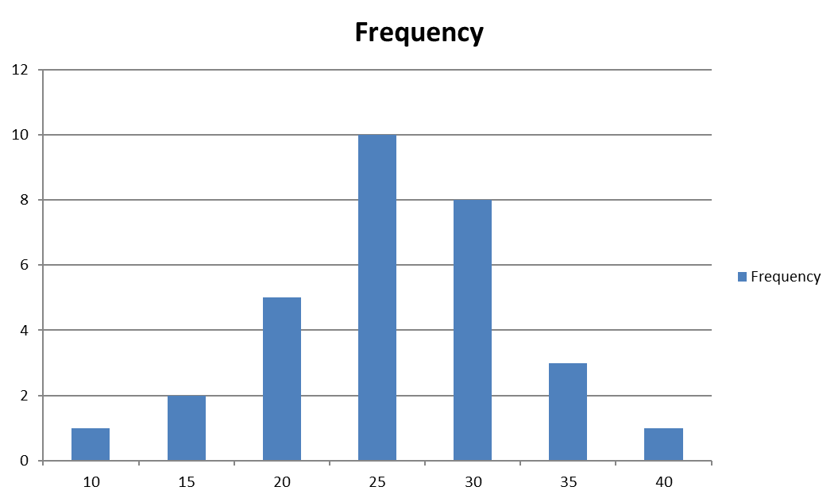
Time A
Time M
Time B
Assume a Beta-distribution

Slide 36
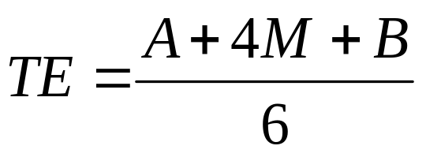
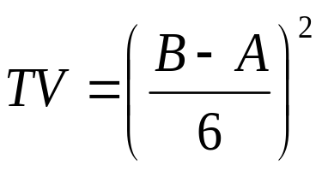
Expected Time and Variance
Mean expected Time
Time Variance
Calculate Earliest Start and Latest Start times as for CPM
Assume that times are Gaussian (Normally) distributed due to Central Limit Theorem

Slide 37
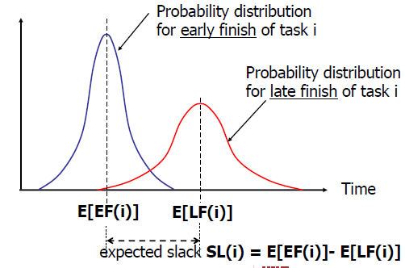

Slide 38
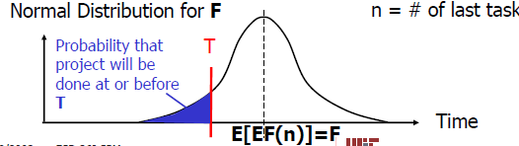
Probability of Meeting Target Time/Date

Slide 39
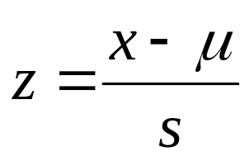


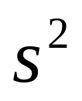

Normal Random Variable z
Compute
Look up probability in a standard normal probability table (Could also use =NORMSDIST(z) in MS-Excel)
Note: is the target time/date
is the expected completion time
is the sum of the variances of all activities that fall on the networks critical path. Therefore take the square root of this quantity for .

Slide 40
Summary
Milestone (Event)
  Represents a specific accomplishment (physical or intellectual) and takes place at a particular instance of time, and does not, therefore, consume time or resources
  Each event requires a unique identifier for analytical purposes and the symbol can also contain a description

Slide 41
Summary
Activities
  Represents what is to be done between the achievement of any two milestones, these being the preceding and succeeding events of the activity. An activity cannot be started until its preceding event has been achieved.
  An activity may represent a task, a management decision, a restraint or a lead time. Activities usually make use of time and resources, although some only use time, and some neither time nor resources. Where the activity does not use resources, it is known as a dummy activity.

Slide 42
Dummy activities and real-time activities
An activity that takes no time and does not utilize any resources
Used to show the dependence of one event on another where no resources are required and no time is taken between milestones
Represented in the network by a broken line joining preceding and succeeding milestones, the arrowhead showing the sequence
An activity that does not use resources but does take time to complete is known as a real-time dummy activity. This is used to show when time must elapse between achievement of both events.

Slide 43
Cost/Time trade-off
Most activities can be done faster if you pay more money
  Work overtime / hire more people / rent extra equipment / incentive contracts
  PERT / CPM have ability to crash a schedule. i.e., to shorten activity time in a network to reduce project completion time.

Slide 44


